Slide 1
Agile, SCRUM, Lean

Slide 2
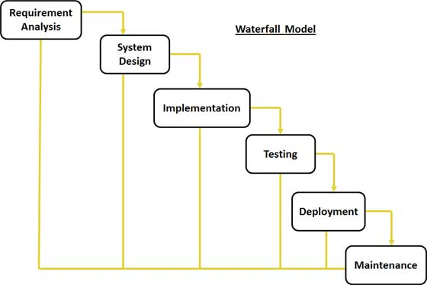
Software Development Process

Slide 3
Agile Principles
Customer satisfaction by rapid delivery of useful software
Welcome changing requirements, even late in development
Working software is delivered frequently
Continuous attention to technical excellence and good design
Simplicity—the art of maximizing the amount of work not done—is essential

Slide 4
Agile
Agile software development is a group of software development methods based on iterative and incremental development, where requirements and solutions evolve through collaboration between self-organizing, cross-functional teams

Slide 5
SCRUM
Scrum is an iterative and incremental Agile software development framework for managing software projects and product or application development

Slide 6
SCRUM - Roles
Product owner
Development team
  A cross functional team
Scrum master
  Removing impediments to the ability of the team to deliver the sprint goal/deliverables

Slide 7
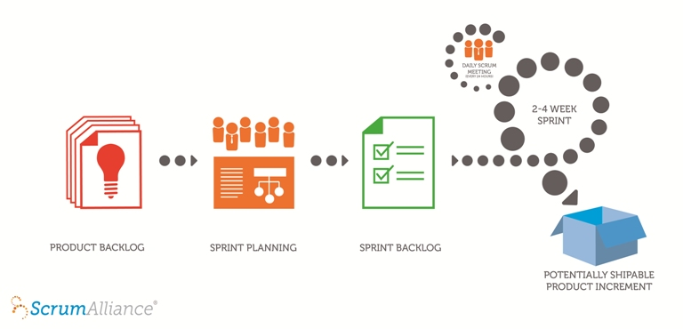
SCRUM Process
Notes:
A sprint backlog is a list of the product backlog items the team commits to delivering plus the list of tasks necessary to delivering those product backlog items.

Slide 8
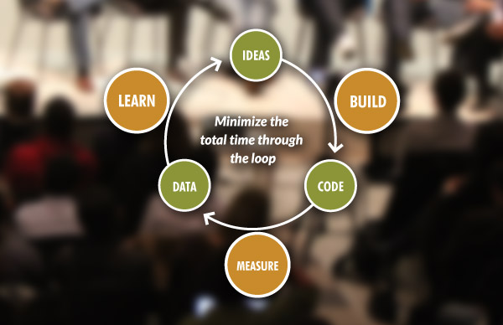
LEAN Startup

Slide 9
THANK YOU

